Slide 1
Building Literacy Capacity for all students across curriculum
Welcome!

Slide 2
Today’s Agenda
Admire the Problem: Grappling with Complex Texts
Find the Solution: Common Language & Skills
Understand the Strategy
Develop the Action Plan
Full Circle Wrap Up
Questions / Contact Info

Slide 3
Admire the Problem
Don’t want to read? Google it! Everything on the internet is true, right?
Kids live in an everything-on-the-internet-is-true world where “goggle” is a common verb
That being said, educators are having an increasingly difficult time getting kids to grapple with complex texts
Kids don’t always possess the perseverance and stamina needed to truly internalize difficult content readings & materials

Slide 4
Find a Solution
While there is no “magic bullet,” there may be a silver lining….
Common language (reading vocabulary terms)
Common literacy skills used to tackle difficult texts Common strategies/tools used to develop these literacy skills
Common meaning = across curriculum, across secondary 6-12!

Slide 5
Find a Solution
So…. Our ultimate goal is to:
Model and teach skills that will help students internalize essential reading behaviors, and when done frequently, employ automatically to difficult texts across the curriculum.
We want our students to develop the perseverance and stamina needed to truly understand difficult content reading & materials

Slide 6
Understand the Strategy
Specifically designed Close Reading + RAFT (motivational writing and thinking tool) = gives students the ability to and the reasoning for tackling complex texts (HOW and WHY)

Slide 7
Part I: Specifically Designed Close Reading
Specifically designed Close Reading + RAFT (motivational writing and thinking tool) = gives students the ability to and the reasoning for tackling complex texts (HOW and WHY)
_________________________________________________
What really is Close Reading?
The careful interpretation of a text wherein readers pay close attention to the way ideas unfold as they read (deep comprehension)
Often, this involves annotating texts for the sake of slowing down and recording thinking so that readers can internalize and manipulate new information (interacting with text)

Slide 8
Specifically Designed Close Reading
Close reading can be explained and utilized in a variety of ways…..
BUT keeping in mind our goal of using common language and developing common approaches to strategies, we will focus on:
First Draft Reading to introduce content
Setting a purpose to read for a reason
Second Draft Reading to select and organize information
Third Draft Reading to clarify meaning and ask specific questions

Slide 9
Specifically Designed Close Reading
Can’t argue with research……
A significant body of research links close reading of complex text—whether the student is a struggling reader or advanced—to significant gains in reading proficiency
AND increased understanding of difficult content material
AND a key component of college and career readiness.

Slide 10
Part II: RAFT
Specifically designed Close Reading + RAFT (motivational writing and thinking tool) = gives students the ability to and the reasoning for tackling complex texts (HOW and WHY)
What really is a RAFT?
RAFT is a motivational writing and thinking tool:
R = Role (Who are you as the writer?)
A = Audience (To whom are you writing?)
F = Format (What form will your writing assume?
T = Topic (What subject are you writing about?)

Slide 11
What will it look like for…me?
Check out the RAFT samples below…
Keep in mind:
The science (common language and common usage) is the same but the art (the creation and development) is all yours!
RAFT must tie directly to your reading and thus your essential learnings, notice how for each RAFT example the learning box indicates what the students should know, understand and be able to do

Slide 12
Physical Education RAFT
Students should know/understand:
How an individual can keep himself healthy
What specifically keeps the heart healthy
Warning signs that the body/heart is not functioning properly
Effects of having an unhealthy heart
For example…
R = The heart
A = Lazy teenager
F = Persuasive letter
T = Understanding of how to keep me healthy

Slide 13
Music RAFT
For example…
R = Rest
A = Band students
F = Memo
T = Reprimand for improper use / explanation of appropriate use
Students should know/understand:
The role of a rest
The appropriate uses of the rest in playing certain pieces of music
How to apply it to their own instrument

Slide 14
Math RAFT
Students should know/understand:
The triangle has two equal sides and thus two equal angles
By the isosceles triangle theorem, the two angles opposite the equal sides are themselves equal, while if the third side is different then the third angle is different
Understand base, legs, vertex angles, base angles
For example…
R = Isosceles triangle
A = My angles
F = E-mail
T = Our unequal relationship

Slide 15
Tech RAFT
For example…
R = Safety specialist
A = Careless student
F = Safety quiz
T = Things you need to know before you operate the mitre saw
Students should know/understand:
The names and uses of safety equipment
The specific steps in operating a mitre saw
The precautions and measures one must take prior to beginning a project
Procedure for emergencies

Slide 16
Science RAFT
Students should know/understand:
Safe chemical combinations
Purpose of chemical combinations
Unsafe chemical combinations
Why certain combinations should not be made
Instructions on how to safely handle chemicals
For example…
R = Chemist
A = Chemical Company
F = Instructions
T = Dangerous combinations to avoid and why

Slide 17
Health RAFT
For example…
R = Lungs
A = Cigarettes
F = Complaint
T = Effects of long-term smoking
Students should know/understand:
Addictive nature of cigarettes
The effects of long-term smoking to the smoker
The effects of second-hand smoking
Appropriate ways to kick the habit

Slide 18
English RAFT
For example…
R = George Milton (Of Mice and Men)
A = Other migrant workers, 1930s
F = Opinion piece to farmer’s magazine
T = Conditions and emotions felt on the ranch
Students should know/understand:
The role migrant workers played in the 1930s
The way of life for George on his particular farm
Emotions/depth of George Milton as a literary character

Slide 19
Social Studies RAFT
For example…
R =Doctor with the World Health Organization
A = Listeners to a radio talk show
F = Interview transcript
T = Your experiences with the 2004 tsunami in eastern Asia
Students should know/understand:
The role of the World Health Organization
The specifics of the 2004 tsunami in Asia
The effect of the tsunami on the Asian people
The effect of the tsunami on the Eastern Asia’s landscape
The importance of natural disasters in our nation’s history

Slide 20
RAFT
RAFT allows teachers and students to get creative - the writing can be exciting and fun!
Like close reading, RAFT can be explained and utilized in a variety of ways…. Once again, keep in mind our goal of common language and approach:
RAFT is a thinking, writing and even assessment tool, but the target is still the automaticity of the close reading skills
When used together (close reading with the RAFT writing), we are giving students an amazing recipe for tackling complex texts

Slide 21
RAFT Research
RAFT builds the capacity of our students by:
Increasing motivation
Meeting needs through differentiation
Strengthening critical and creative thinking
Developing an understanding of other perspectives
Fostering autonomy
Writing for authentic purposes / audience other than teacher

Slide 22
Action Plan
Refocus:
We admired the problem, found a solution, and understand the why and how of the strategy….. Now comes the ACTION PLAN
HOW do we make this work for students?

Slide 23
Action Plan
Let’s take a look at the implementation guide as a way to see how implementation in the classroom may look…

Slide 24
Explicit Instruction = Success
The way the reading skills and RAFT strategy are modeled will determine the success of student implementation
Close reading strategies can’t simply be handed out on a chart; RAFT writing can’t simply be an assignment
Taking students through the gradual release process allows them to begin internalizing and understanding the skills…(our goal!)

Slide 25
Explicit Instruction = Success
HOOK students on concept; introduce strategy
MODEL: Model your own thinking while reading, work through RAFT writing process in front of them
GUIDED PRACTICE: Allow students to create a model with you or enlist their help with a complex reading
Repeated INDEPENDENT PRACTICE & APPLICATION of skills in other readings/units/etc.

Slide 26
Differentiation for ALL Learners
These specific close reading strategies and RAFT lend themselves well to differentiation:
After modeling and practice, students can work together to create their own RAFTS.
Teachers can differentiate the type of writing expected.
Different prompts can be given to different learners OR the same prompt can be given but vary the reading (text complexity).

Slide 27
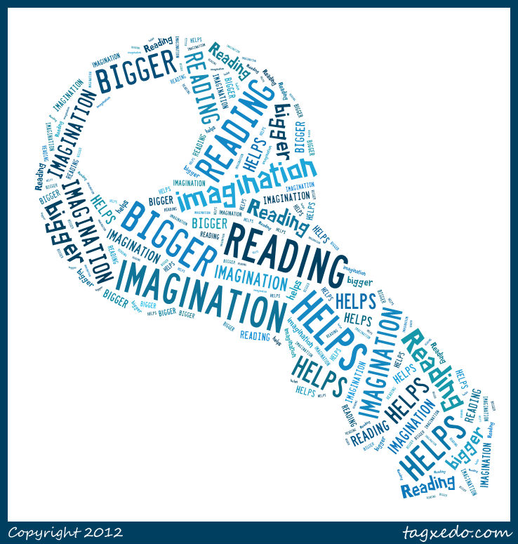
Full Circle ~ Wrap Up…
Students who use specific close reading strategies learn more content because they actively interact with the information at a higher level of cognitive processing (Billmeyer, 2003).
RAFT develops critical thinkers by allowing students to make personal meaning – students examine content in new and different ways.
RAFT provides a structured organizational pattern for writing (explaining the material) but allows for creativity.

Slide 29
Contact Info
Handout: Instructional Coaching Model
I’m here to help!!
First two roles may be especially helpful in conjunction with what you learned today: classroom supporter and instructional supporter
Today’s bonus = In-house training with people that can follow-up with support! ☺ ☺

